Slide 1
LECTURE 1: C #
Introduction AND DOWLODING OF VISUAL STUDIO.

Slide 2
INTRODUCTION
1. C# (pronounced "See Sharp") is a modern, object-oriented, and type-safe programming language. C# enables developers to build many types of secure and robust applications that run in the .NET ecosystem. C# has its roots in the C family of languages and will be immediately familiar to C, C++, Java, and JavaScript programmers.
2. C# is an object-oriented, component-oriented programming language. C# provides language constructs to directly support these concepts, making C# a natural language in which to create and use software components. Since its origin, C# has added features to support new workloads and emerging software design practices.

Slide 3
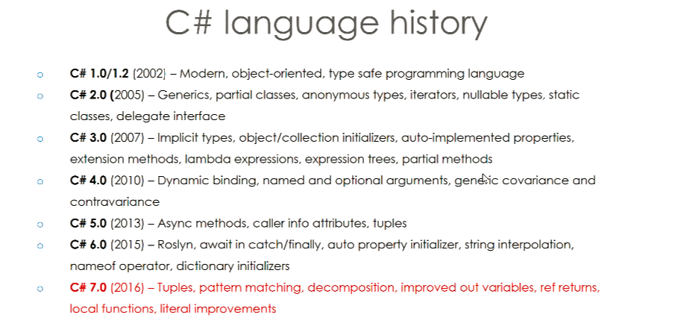
History of c#

Slide 4
Versions
C# 1.0.NET framework 1.0,1.1 , CLR version 1.0, Visual Studio 2002.
C# 2.0 .NET framework 2.0 , CLR version 2.0, Visual Studio 2005.
C# 3.0 .NET framework 3.0,3.5 , CLR version 2.0, Visual Studio 2008.
C# 4.0 .NET framework 4.0 , CLR version 4.0, Visual Studio 2010.
C# 5.0 .NET framework 4.5 , CLR version 4.0, Visual Studio 2012,2013.
C# 6.0 .NET framework 4.6 , CLR version 4.0 ,Visual Studio 2013,2015.
C# 7.0 .NET framework 4.6,4.6.1,4.6.2 , CLR version 4.0, Visual Studio 2015, 2017 RC.

Slide 5
Current version
C# 7.3
The current version of C# is C# 7.3.
Noted: C Sharp”. It was developed by Microsoft led by Anders Hejlsberg and his team within the .NET initiative and was approved by the European Computer Manufacturers Association (ECMA) and International Standards Organization (ISO). The current version of C# is C# 7.3.

Slide 6
common language runtime (CLR)
C# programs run on .NET, a virtual execution system called the common language runtime (CLR) and a set of class libraries. The CLR is the implementation by Microsoft of the common language infrastructure (CLI), an international standard. The CLI is the basis for creating execution and development environments in which languages and libraries work together seamlessly.
Source code written in C# is compiled into an intermediate language (IL) that conforms to the CLI specification. The IL code and resources, such as bitmaps and strings, are stored in an assembly, typically with an extension of .dll An assembly contains a manifest that provides information about the assembly's types, version, and culture.

Slide 7
What is FCL and CLR
CFL: framework contains a large number of class libraries known as Framework Class Library (FCL)
CLR: The software programs written in .NET are executed in the execution environment, which is called CLR (Common Language Runtime).

Slide 8
CLR (Common Language Runtime)
CLR IS : a program execution engine that loads and executes the program. It converts the program into native code. It acts as an interface between the framework and operating system. It does exception handling, memory management, and garbage collection. Moreover, it provides security, type-safety, interoperability, and portability.

Slide 9
CLR components
The key components of CLR includes the following:
Class Loader - Used to load all classes at run time.
MSIL to Native code - The Just In Time (JIT) compiler will convert MSIL code into native code.
Code Manager - It manages the code at run time.
Garbage Collector - It manages the memory. Collect all unused objects and de-allocate them to reduce memory.
Thread Support - It supports multithreading of our application.
Exception Handler - It handles exceptions at run time.

Slide 10
Important Noted point
1. CIL or MSIL | Microsoft Intermediate Language or Common Intermediate Language. The Microsoft Intermediate Language (MSIL), also known as the Common Intermediate Language (CIL) is a set of instructions that are platform independent and are generated by the language-specific compiler from the source code.
A framework, or software framework, is a platform for developing software applications. ... For example, a framework may include predefined classes and functions that can be used to process input, manage hardware devices, and interact with system software.

Slide 11
Noted points
A library provides a set of helper functions/objects/modules which your application code calls for specific functionality.
A class library defines types and methods that are called by an application
FCL: It is a standard library that is a collection of thousands of classes and used to build an application.
The BCL (Base Class Library) is the core of the FCL and provides basic functionalities.

Slide 12
Important points
Component-Oriented Programming
Component-oriented programming is a technique of developing software applications by combining pre-existing and new components, much the same way automobiles are built from other components. Software components are self-contained, self-describing packages of functionality containing definitions of types that expose both behavior and data.
C# supports component-oriented programming through the concepts of properties, methods, events, and attributes (or metadata), allowing self-contained and self-describing components of functionality called assemblies

Slide 13
Important
A namespace is a declarative region that provides a scope to the identifiers (the names of types, functions, variables, etc.) inside it.
Type safety means that the compiler will validate types while compiling, and throw an error if you try to assign the wrong type to a variable.

Slide 14
Assignment
What is deference between library and framework.
What is Framework Class Library (FCL) and CLR (Common Language Runtime).

